Slide 1
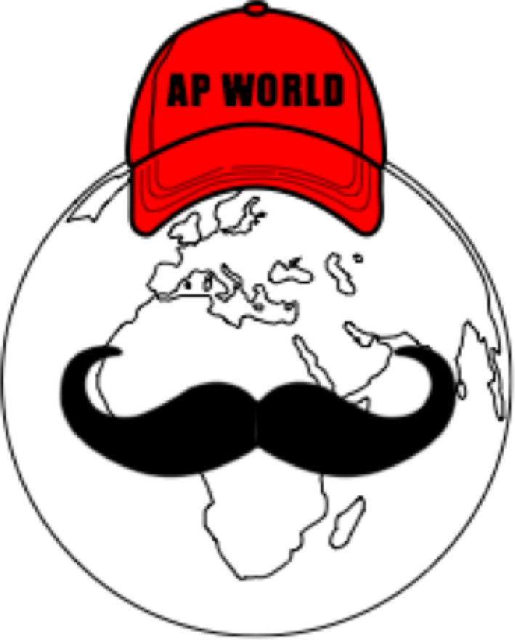
AP World Review: Modern: Video #8: Topic 2.1
Everything You Need To Know About Topic 2.1 To Succeed In AP World Modern
www.APWorldReview.com

Slide 2
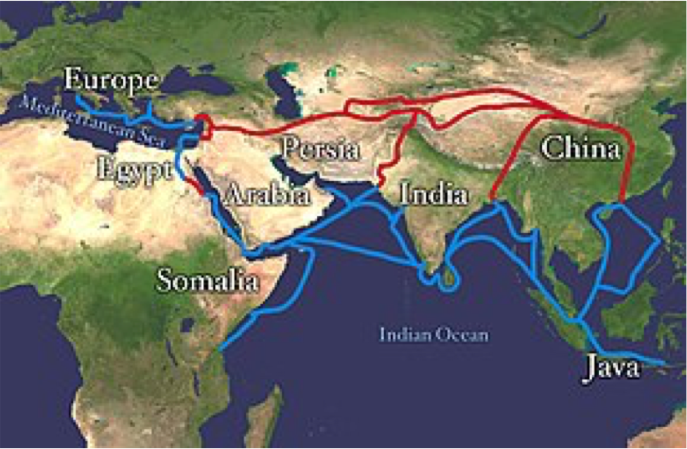
The Silk Roads
Connected large civilizations, pastoralists, and agriculturalists throughout Eurasia
Products were made for sale in distant markets
Chinese silk in Rome - seen as a symbol of wealth and status
Most people would travel and trade on only specific parts of the Roads
When large states were powerful and provided security, the Silk Roads prospered

Slide 3
The Silk Roads
Goods that were traded?
From China:
Silk, gunpowder, paper, mirrors
Chinese women produced a significant amount of silk in their homes
From India:
Textiles, medicine, spices, pepper
From the Middle East:
Dates, nuts, dried fruit, swords
From the Mediterranean:
Gold, jewelry, perfume, olive oil
Disease also spread on the Silk Roads

Slide 4
Innovations That Encouraged Trade
Caravanserai:
Roadside inns for travelers on the Silk Road
Forms of credit:
Paper $ - Song Dynasty
Bills of exchange - promised to pay a person

Slide 5
Important Cities On The Silk Roads
The Silk Roads fostered the growth of cities:
Constantinople - Byzantine Empire
Baghdad during the Abbasid Dynasty
Cultural center as well - House of Wisdom
Kashgar
Northwestern China, dates back to the Han Dynasty (200 C.E.)
Samarkand
Uzbekistan, located between China and the Mediterranean
One of the greatest cities of Central Asia

Slide 6
Impact Of Silk Roads
Demand for luxury goods increased in Afro-Eurasia
Textiles and porcelains were exported throughout Afro-Eurasia
Iron and steel manufacturing increased in China

Slide 7
Quick Recap
Innovations that helped the Silk Roads
Caravanserai, forms of credit, paper $
Increased demand for luxury goods throughout Afro-Eurasia
Increased textile, porcelains, and steel

Slide 8
See You Back Here For Video #9: Topic 2.2!
Thanks for watching
Best of luck in May!

