Slide 1
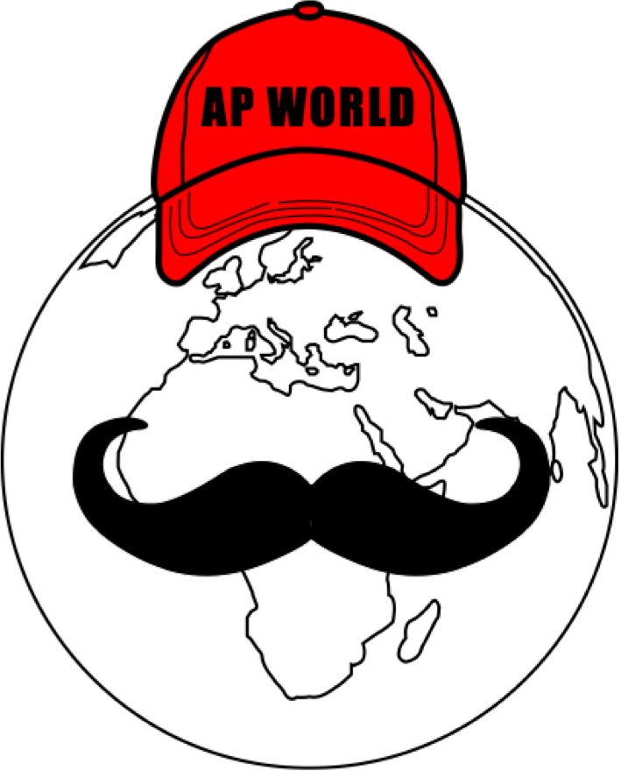
AP World Review: Modern: Video #7, Topic 1.7
Everything You Need To Know About Topic 1.7 To Succeed In AP World Modern
www.APWorldReview.com

Slide 2
Similarities & Differences Of State Formation From 1200 - 1450 C.E.
Asia - Song Dynasty and Abbasid Dynasty
Africa - Mali, Great Zimbabwe
Americas - Aztecs and Incas

Slide 3
What Does State Formation Mean?
States are civilizations/areas with a single political government
During this time, states are being formed

Slide 4
Similarities In State Formations
Religion/Belief systems were often used by the government
Song Dynasty - Confucianism
Civil Service Exam
Abbasid Dynasty - Islam
Mali - Islam
India - Caste System
Europe - Catholic Church
Taxes/labor will will support government/bureaucracy
Taxes in Song China
Mita system under the Incas

Slide 5
Similarities In State Formations
Tribute System:
Aztecs
Song Dynasty - kowtowing
Innovations by states:
China - gunpowder, paper $, porcelain, printing, fast-ripening rice from Vietnam
Mayans - calendar, writing system
Aztecs - chinampas, calendar
Incas - terraced fields, roads
Mali - center of learning, Timbuktu - trading city,

Slide 6
Differences In State Formations
Song Dynasty flourished during this time, whereas the Abbasid Empire was collapsing
Turkic people took over the former Abbasid Empire
Western Europe was decentralized and did not have much contact with Asia
Mayan City-States

Slide 7
See You Back Here For Video #8: Topic 2.1
Thanks for watching!
Best of luck

