Slide 1

AP World Review: Modern: Video #5: Topic 1.5
Everything You Need To Know About Topic 1.5 To Succeed In AP World
www.APWorldReview.com

Slide 2

West Africa - Mali
Founded after the decline of Ghana
  Founded by Sundiata
    Exiled from Mali, later returned in 1235 and became king
13th - 15th centuries - peak
Timbuktu - major wealthy city
  Center of Islamic learning

Slide 3
Mali - Mansa Musa
Grand-nephew of Sundiata
Made a pilgrimage to Mecca (hajj) in 1324
  Brought 100 camels, 1,000s of people, and an obscene amount of gold
    Inflation in Alexandria, Egypt
After his pilgrimage, he established religious schools, built mosques, and encouraged religious learning
By the late 15th century, Songhay took over as the major kingdom of West Africa

Slide 4
East Africa - Zimbabwe
12th - 15th centuries
Location - modern day Zimbabwe and Mozambique
Focused on agriculture, trade, and GOLD
  Traded with Swahili city-states, Persia, India, and China
Wall of stone surrounded the capital, Great Zimbabwe
  20,000 people lived there
Overgrazing led to abandonment

Slide 5
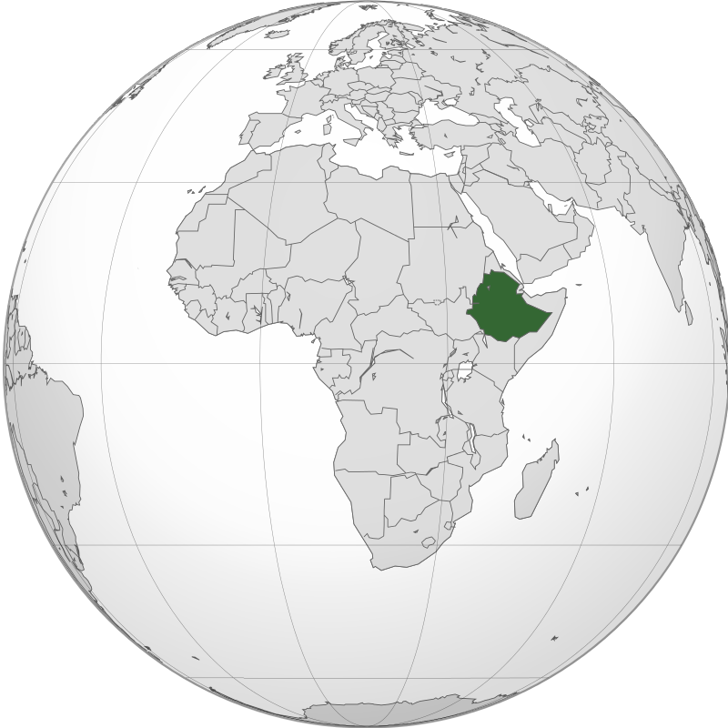
Ethiopia
Ethiopia practiced Christianity beginning in the 12th century
  Developed independently from the Roman Catholic Church and Eastern Orthodox Church
    Combined African elements with Christianity - ancestor veneration, spirits, etc.

Slide 6
Quick Recap
Locations and dates for:
  Mali, Zimbabwe
Timbuktu
Mansa Musa and Islam
Zimbabwe

Slide 7
See You Back Here For Video #6: Topic 1.6
Thanks for watching
Best of luck!

