Slide 1
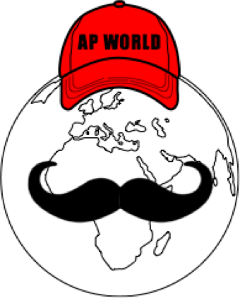
AP World Review: Video #19: The Byzantine Empire (Key Concepts 3.1, I, A, E, 3.2, I, A)
Everything You Need To Know About The Byzantine Empire To Succeed In AP World
www.APWorldReview.com

Slide 2

The Byzantine Empire - An Intro
Emperor Constantine turned the city of Byzantium into Constantinople
While the western half of the Roman Empire fell in the 5th century, the eastern half, the Byzantine Empire prospered
By 527 C.E. the Byzantine Empire stretched across North Africa, Spain, the Mediterranean, and Southwest Asia (Middle East)

Slide 3
Constantinople
The city was surrounded by a defensive wall - protect from invasion
Center for trade
Capital of the Byzantine Empire
Had many libraries, museums, baths, etc.
Named after Emperor Constantine:
  Converted to Christianity
    Claimed divine favor

Slide 4
Structure Of Government
Centralized bureaucracy
Theocracy - no separation between church and state
“Caesaropapism”:
  Head of state is also the head of church

Slide 5
Key People - Justinian & Theodora
Justinian ruled from 527 - 565 C.E.
Church of Hagia Sophia
  Domed structure - example of Christian Architecture
Justinian’s Code:
  Codified Roman law
  Influenced most of Europe and other areas
Expansion under Justinian:
  533 - 565: gained control of Italy, Sicily, North Africa, and Spain
  Defeated the Sassanids in the Middle East

Slide 6
Key People - Heraclius & Leo III
Heraclius (610 - 640 C.E.)
  Resisted Islamic forces from the east
  Reduced the Sassanids power in Southwest Asia
Leo III:
  Byzantine Emperor from 717 - 740 C.E.
  Expanded Byzantine territory in Asia Minor (Turkey)
  Iconoclasm - destroyed religious images and prohibited them in churches

Slide 7
Schism
After tensions between the Roman Catholic Church and Byzantine patriarchs, each excommunicated each other in 1054
  Refused to recognize the other as “properly Christian”
Eastern Orthodox Church and Roman Catholic Church

Slide 8
Trade
Traded with India and China via the Silk Roads
Byzantine coins were a common currency around the Mediterranean Sea

Slide 9
Theme System
Province, called a theme, was under control of a general
  This general was in charge of defense and administration within the theme
  Emperor would appoint generals
Armies recruited free peasants with the promise of land for service

Slide 10
Art And Architecture
Literature focused on Christianity and the lives of Jesus and Mary
Hagia Sophia - largest structure in the world for its time

Slide 11
Muslim Conquests
Saljuq Turks
  1071 - defeated Byzantine army in eastern Anatolia
    More Turks came into Anatolia
  Rejected Byzantine authority, taxed churches
Weakened the Empire until its fall

Slide 12
Decline Of The Empire
Normans took control of Sicily in 1071
4th Crusade (1202 - 1204) - soldiers sacked the city of Constantinople
Constantinople fell to Ottoman Turks in 1453 C.E.
  Renamed to Istanbul

Slide 13
Quick Recap
Significance of Constantinople
Theocracy & Caesaropapism
Justinian and Theodora - Justinian’s Code
Schism
Importance of the Silk Roads
Theme System
Hagia Sophia
Decline of the Empire

Slide 14
See You Back Here For Video #20: Islam
Thanks for watching
Best of luck!

